Slide 1
Distributed modelling
CIE4431 – Hydrological Modelling
Remko Nijzink (with slides from Tanja Euser & Hessel Winsemius)
26 February 2016

Slide 2
Today’s Topics
Why to use distributed models?
What are distributed models?
When and how to use distributed modelling?
Data sources

Slide 3
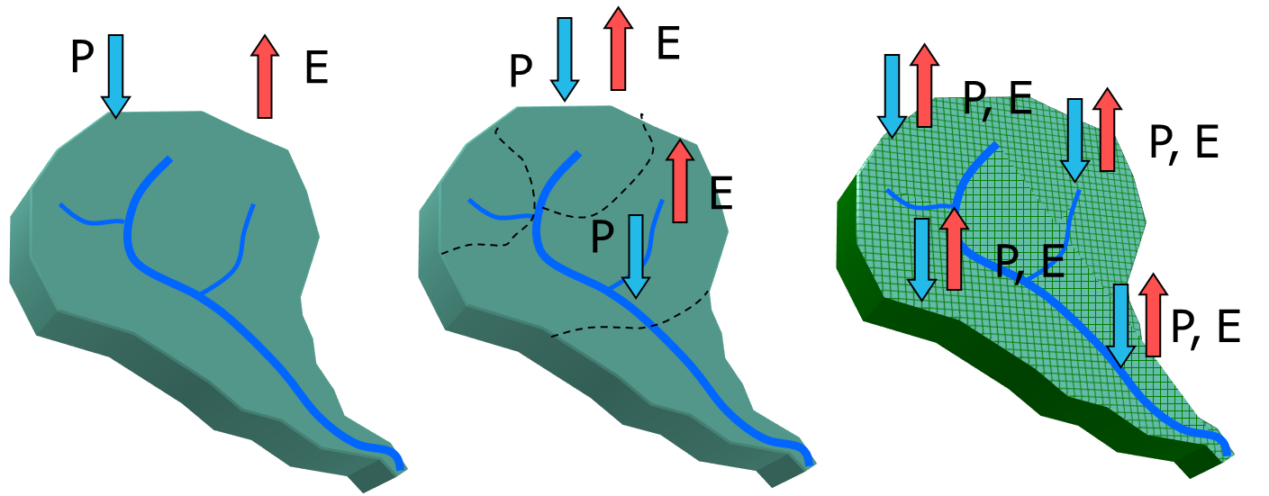
Introduction
lumped vs distributed

Slide 4
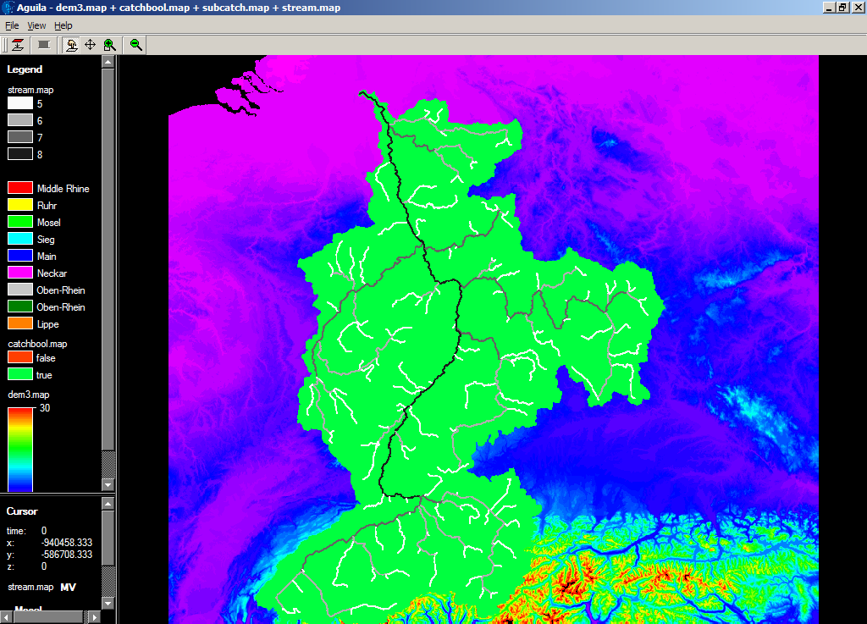
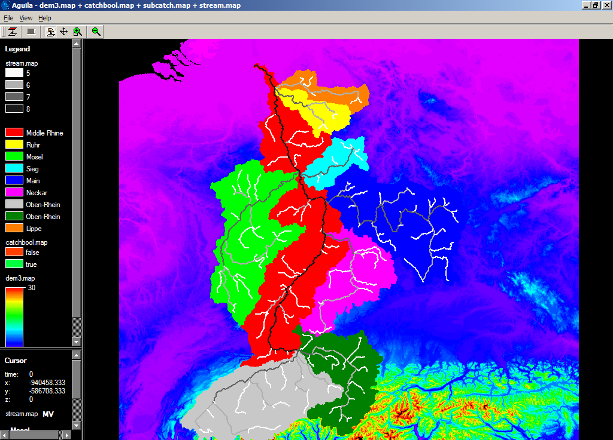
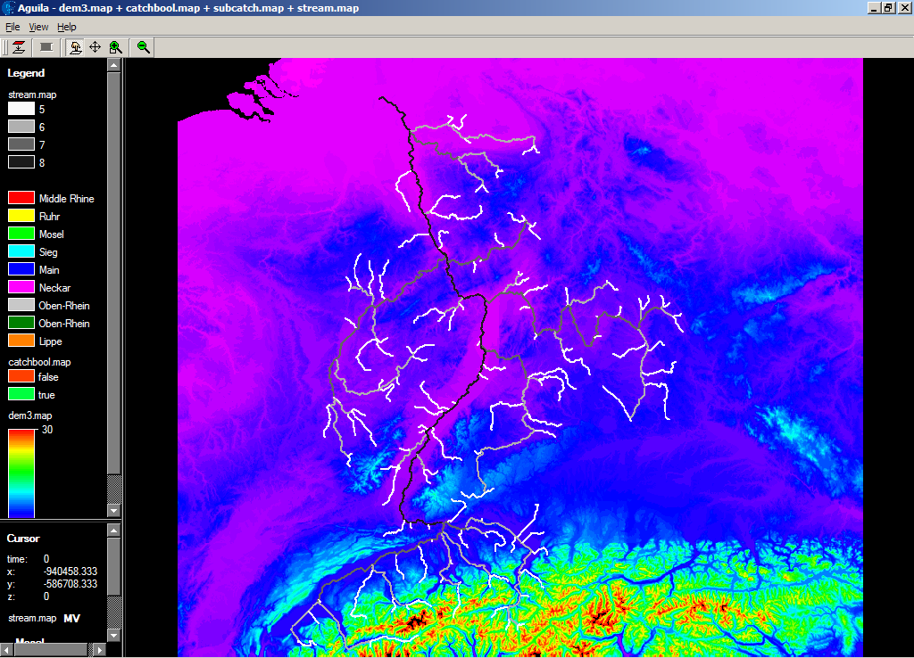
Introduction
lumped vs (semi) distributed
Semi-distributed
Lumped
Lobith

Slide 5
Introduction
Lumped
Advantages
Fast
Easy to implement
Disadvantages
only the outlet (discharge) behaviour or lumped over whole catchment
No internal info → no coupling with e.g. soil erosion or vegetation models
Loss of information on spatial distribution

Slide 6
Introduction
Fully distributed
Advantages
Include distributed data sources (e.g. rainfall)
Include distributed scenarios (e.g. land use change)
Interpret distributed results (e.g. local erosion potential, vegetation changes, include local pollution sources)
Disadvantages
Slower
Equifinality (i.e. distribution of parameters often causes confusion and not necessarily a better model)

Slide 7
Introduction
Semi-distributed
Advantages
Include distributed data sources (e.g. one rain gauge per sub-catchment)
Fast
Disadvantages
Little internal info
Equifinality

Slide 8
Introduction
Reasons to model distributed
Distributed data available, so why not use it?
Drivers
Land use
Known variability in hydrological processes
Evaluate water balance in specific sub-domains
We have a certain question that can only be answered with a distributed model:
…
…

Slide 9
Introduction
Reasons to model distributed
But, be careful!
Extra information can be 'fake'
How good is your distributed input data?
Can you test your results?
Equifinality

Slide 10
What are distributed models?
"Distributed refers to any selection of model structure, parameters or data which is not considered representative for the entire catchment "
What do they consist of?
A (conceptual or physical) model for the water balance
input: rainfall, potential evaporation;
output: evaporation, river discharge, etc.
Often some form of (river) routing

Slide 11
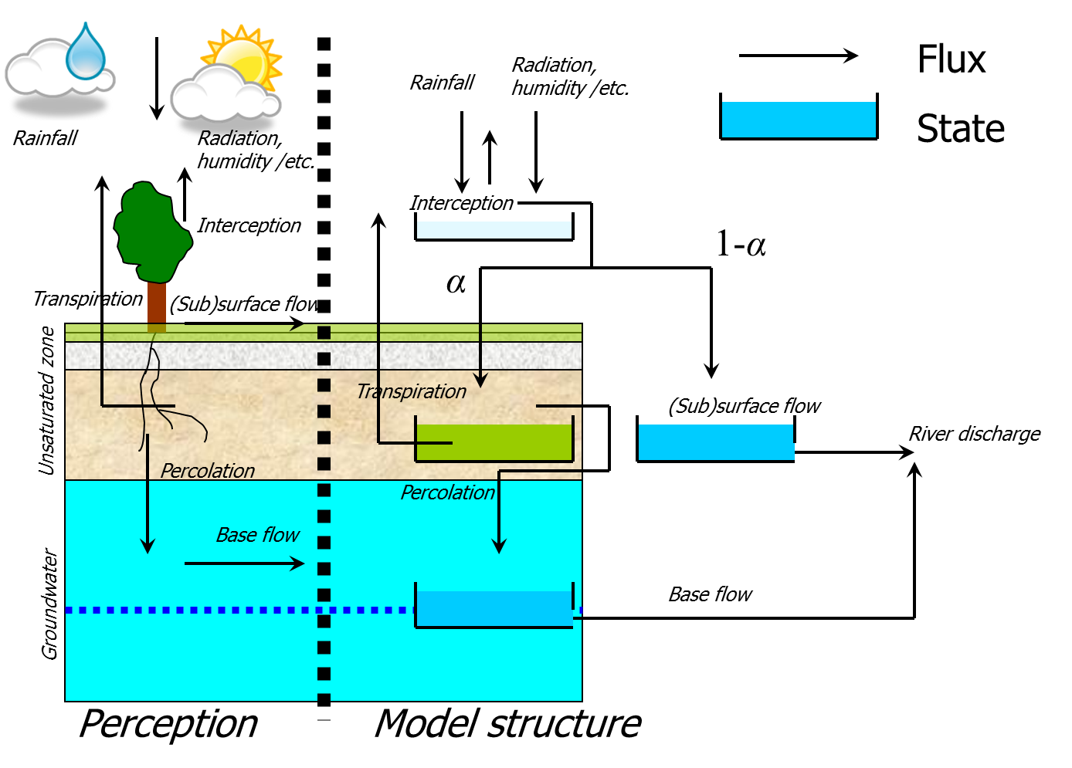
What are distributed models?
Water balance model

Slide 12
What are distributed models?
Water balance model
Rainfall
Evaporation
Each cell has:
Input (e.g. rainfall)
State variables (e.g. soil
moisture, groundwater level)
Output (e.g. evaporation, runoff)
Groundwater outflow goes straight to the river?
What to do with the runoff?
River discharge
Storage dynamics

Slide 13
What are distributed models?
Water balance model
Rainfall
Evaporation
grid
cell
River discharge
Runoff (according to flow direction)
Storage dynamics

Slide 14
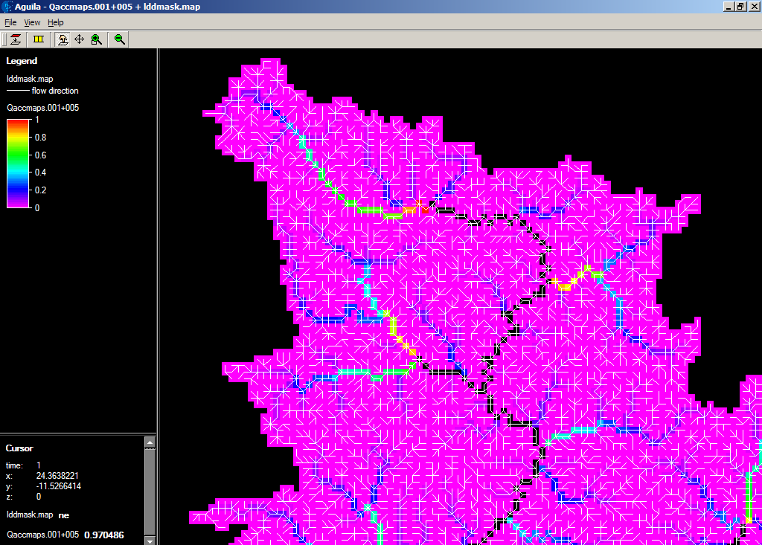
What are distributed models?
Routing

Slide 15
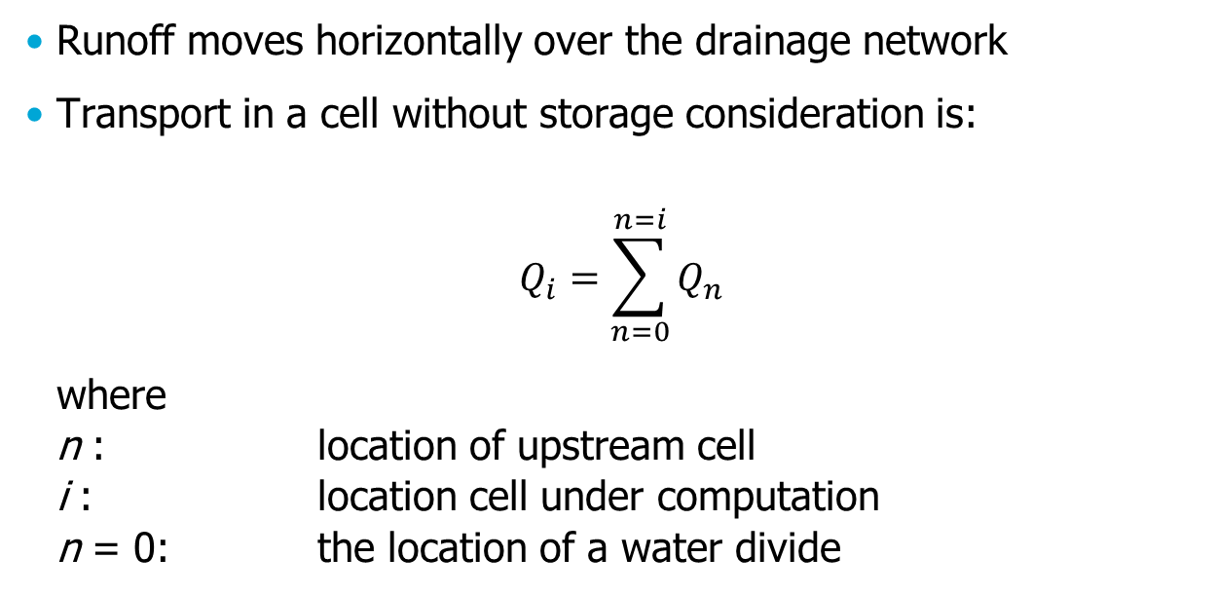
What are distributed models?
Routing
Runoff moves horizontally over the drainage network
Transport in a cell without storage consideration is:
$$Q_{i}=\sum_{n=0}^{n=i}{Q_{n}}$$
where
n : location of upstream cell
i : location cell under computation
n = 0: the location of a water divide

Slide 16
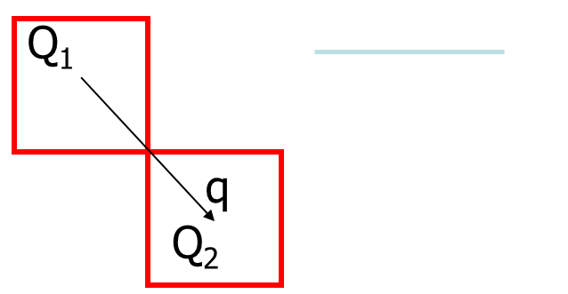
What are distributed models?
Routing
Taking into account that there is channel storage
Kinematic wave approximations

Slide 17
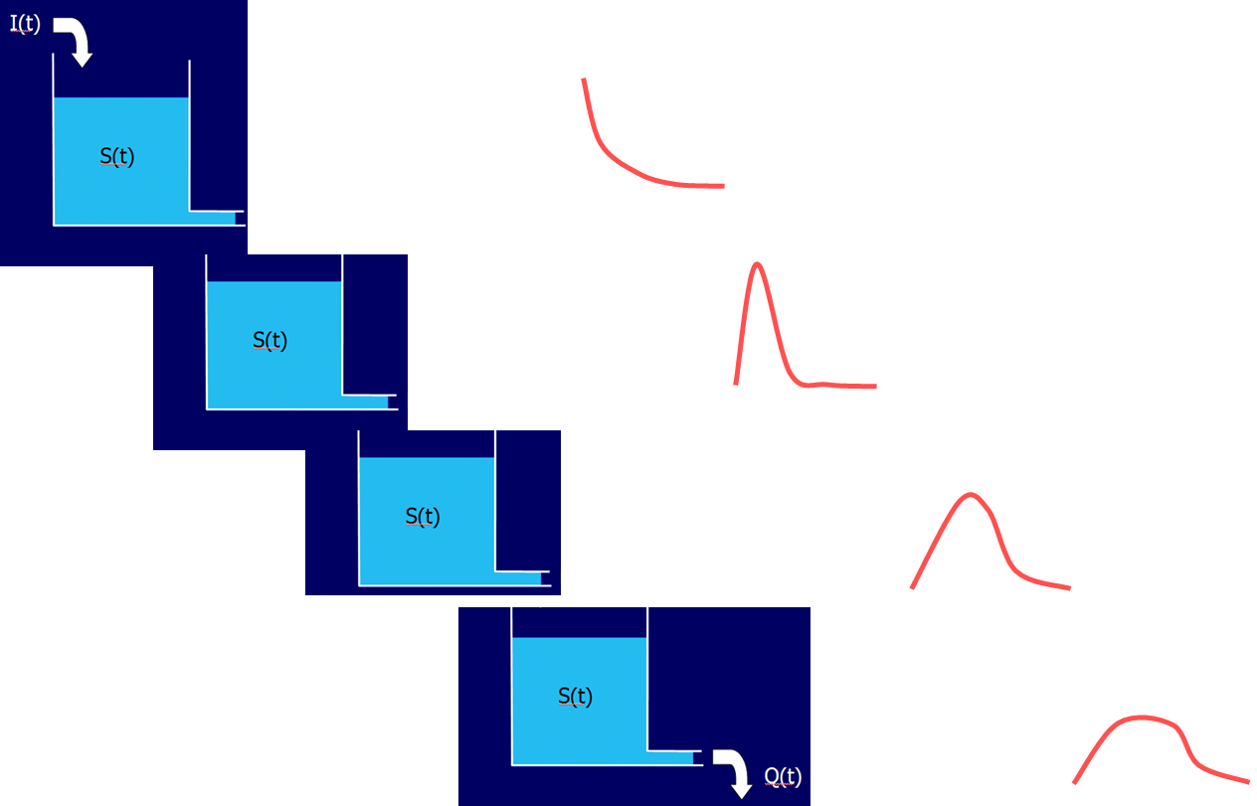
What are distributed models?
Routing

Slide 18
What are distributed models?
Semi-distributed modelling
(Fully-)distributed: grid with usually equal cell-sizes
Gridded rainfall data
Semi-distributed: aggregation of grid-cells in spatial units e.g.:
Location of runoff gauges
According to Strahler order river network
Hydrotope analysis (in between semi-distributed and distributed)
Similar landscape elements
Similar land use elements
Similar ecosystem elements

Slide 19
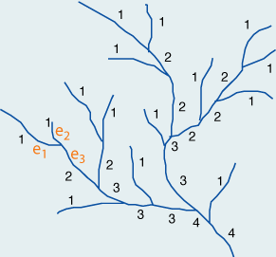
Semi-distributed modelling
Strahler order

Slide 20
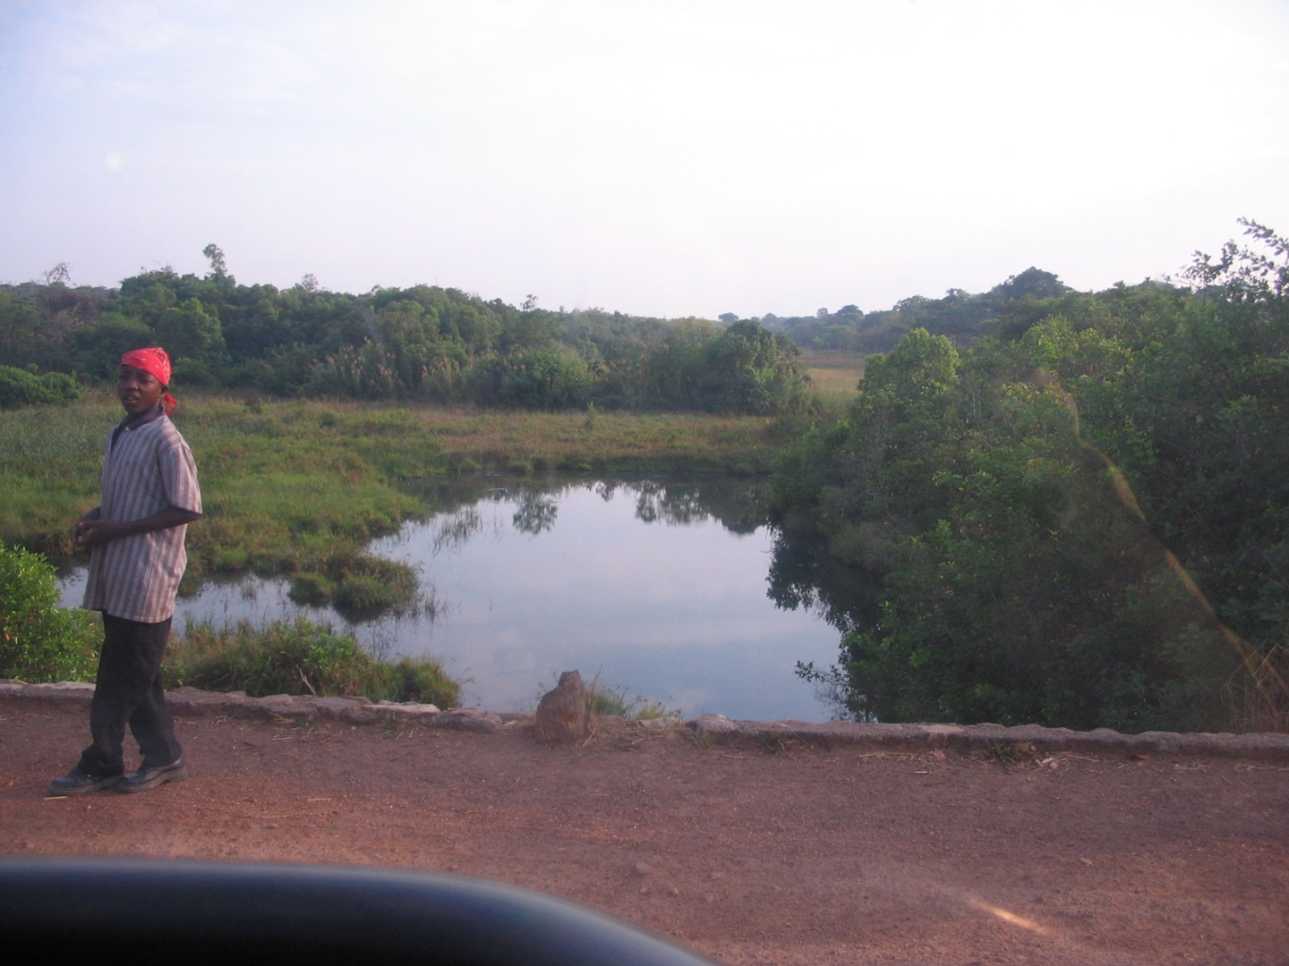
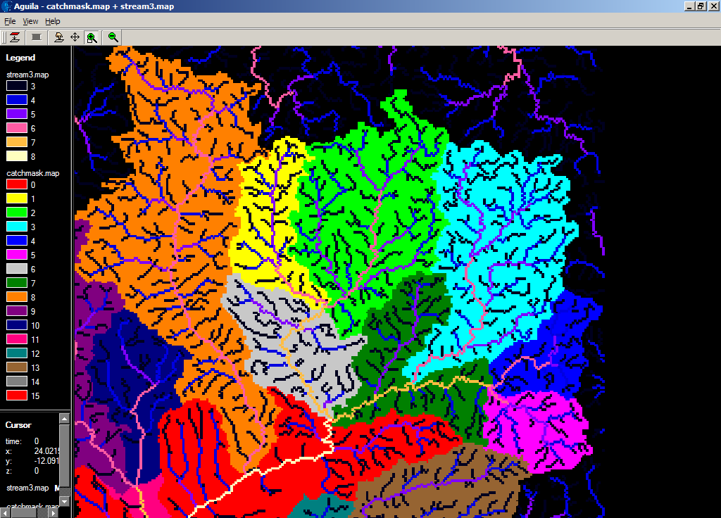
Semi-distributed modelling
Example: Kabompo, strahler threshold?
Lumwana river (4th order stream)
Catchment boundary

Slide 21
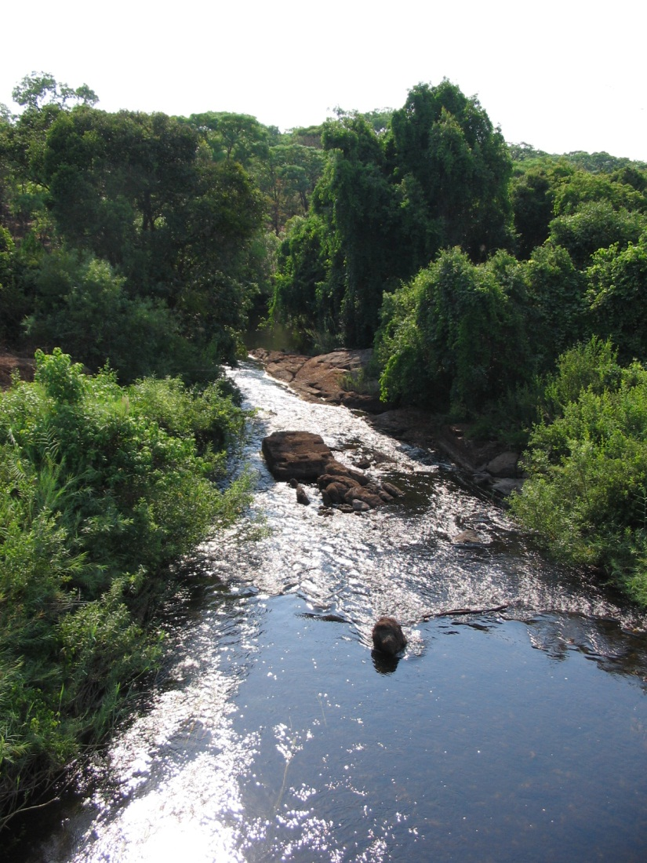
Semi-distributed modelling
Example: Kabompo, strahler threshold?
Kabompo river
(5th order stream)
Catchment boundary

Slide 22
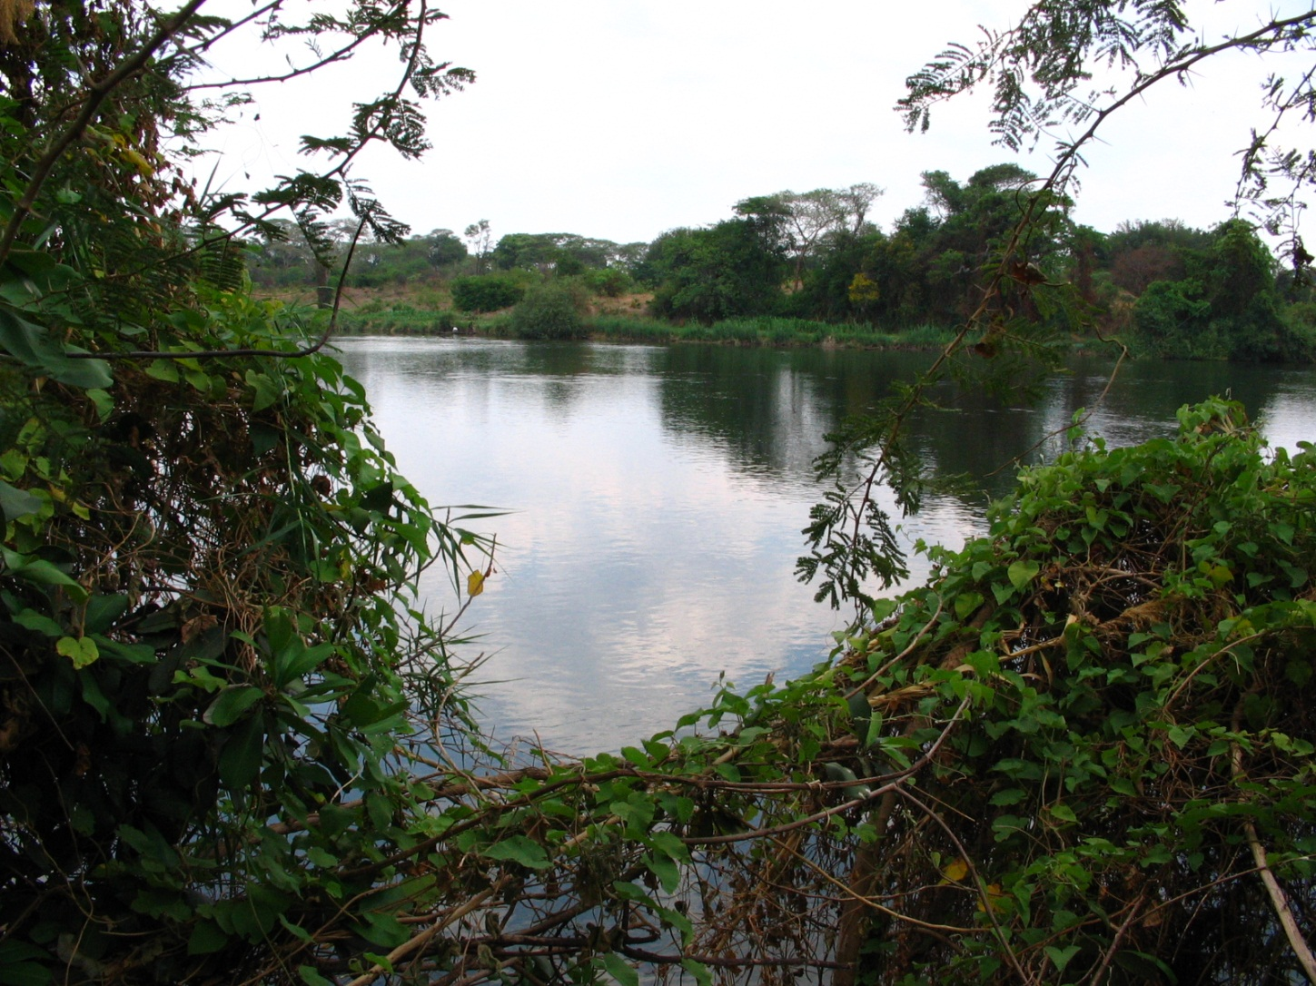
Semi-distributed modelling
Example: Kabompo, strahler threshold?
Kabompo river (8th order stream)
Catchment boundary

Slide 23
Semi-distributed modelling
Hydrological response units
Areas (classes) of assumed similar hydrological behaviour
Remotely sensed/distributed data for delineation
Expert judgment or field examinations recommended
Also known as:
Landscape units
Hydrotopes
Representative watersheds
Classes
Etc…

Slide 24
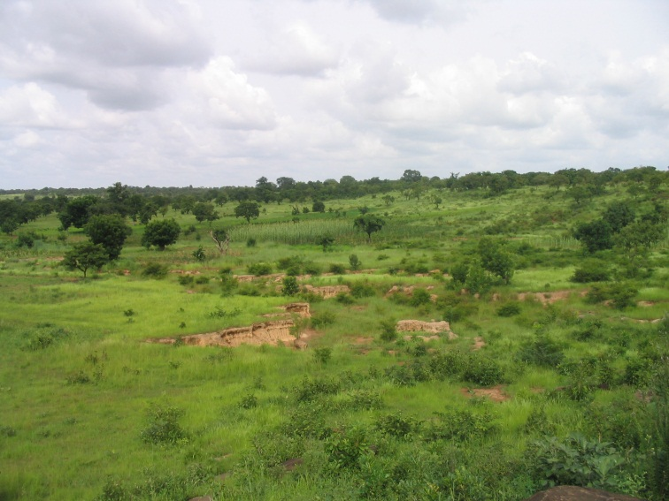
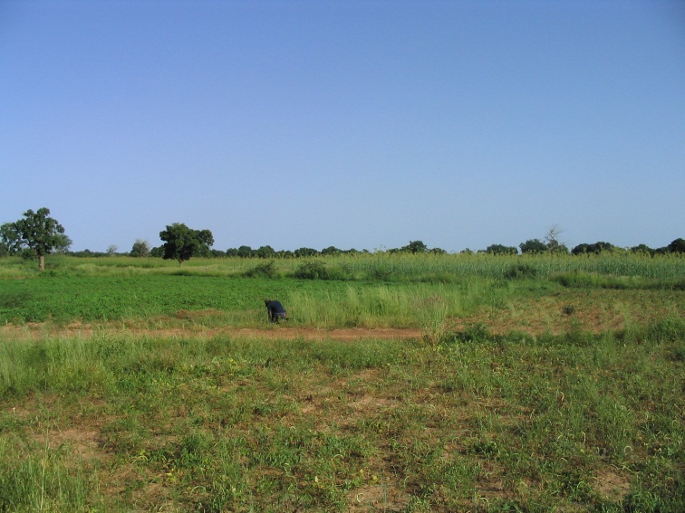
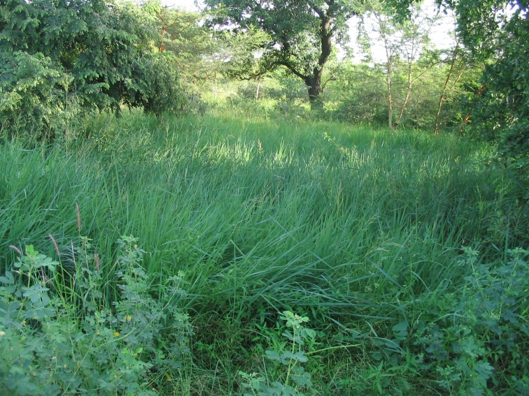
Hydrological response units
Example Volta basin
slopes
plateaus
wetlands

Slide 25
Hydrological response units
LandSAT imagery
Use thresholds to derive the classes
Normalized Difference Vegetation Index (NDVI)
Logical expression:
If NDVI > 0.05, wetland

Slide 26
Hydrological response units
DEM: slopes
Use thresholds to derive the classes
Slope of topography
Logical expression:
If slope > 0.04, hill

Slide 27
Hydrological response units
Classification
1. Plains (DEM)
2. Wetlands (NDVI)
3. Rivers (runoff)
4. Slopes (DEM)

Slide 28
How and when to use distributed modelling?
To start with
Investigate what information you have available
Decide what is suitable to distribute and to what extend
Data availability
Which processes are you interested in?
Area extent
Use the right tools:
Computational time
Programming language/framework
Existing models

Slide 29
How and when to use distributed modelling?
Possibilities
Distribution of input data
Distribution of model
Distribution of parameters
Distribution of model structure
 | Lumped model | Distributed model
Lumped data | Most simple
Distributed data |  | Most complex
Notes:
Example interception on blackboard

Slide 30
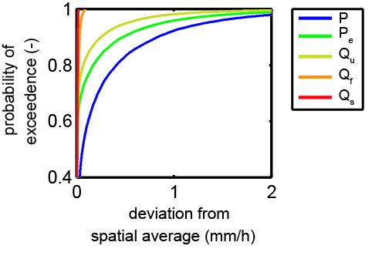
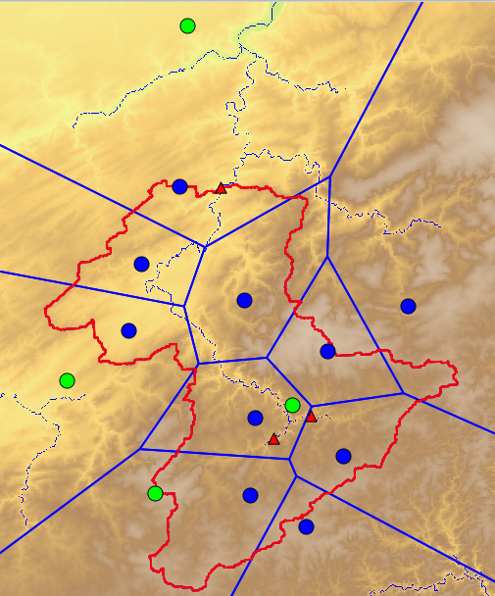
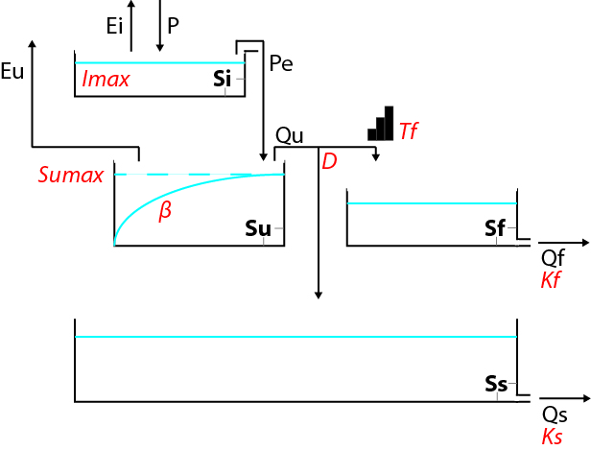
Distribution of input data
Data availability main issue
Heterogeneity of rainfall
Filtering in heterogeneity by model

Slide 31
Distribution of parameters
Often combined with distribution of input data
Not all parameters distributed
Landuse often suitable
Make sure you can justify your distribution

Slide 32
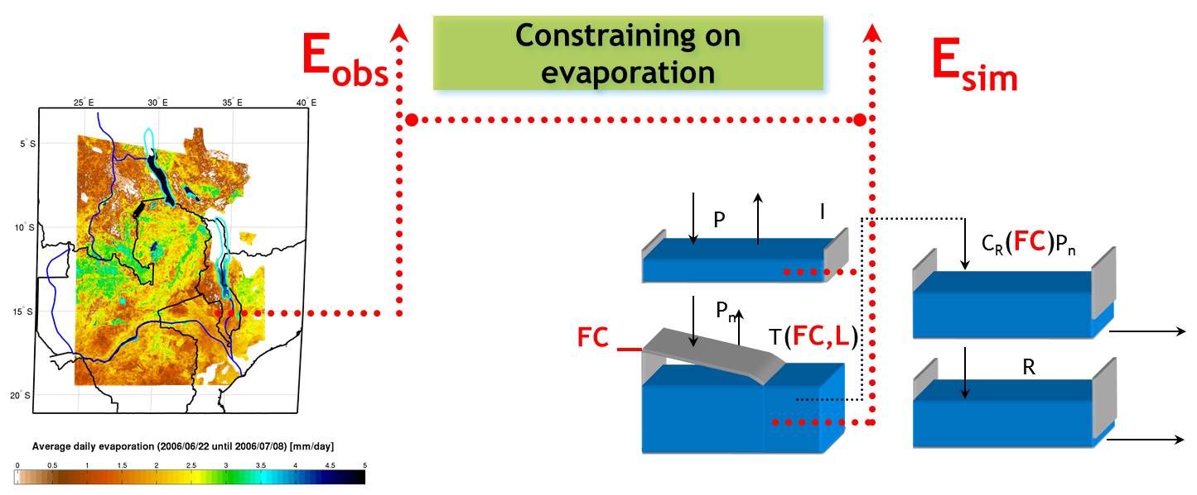
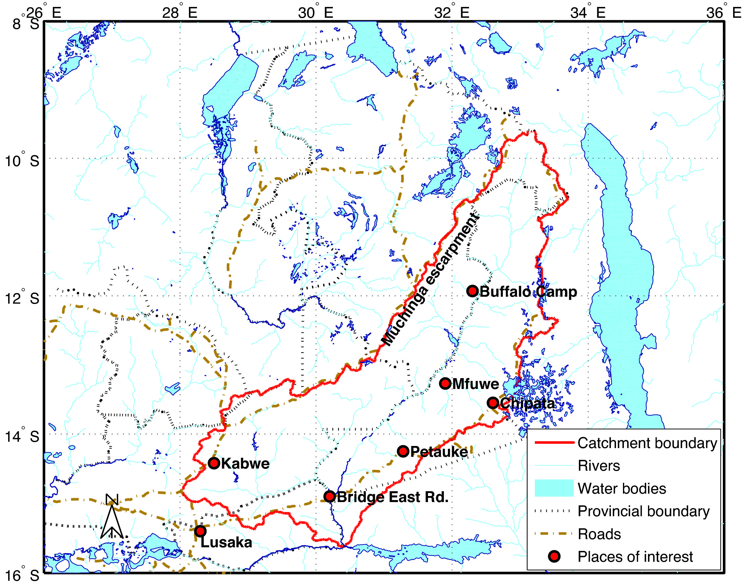
Distribution of parameters
Example Luangwa: constraining on evaporation
Winsemius et. al, HESS, 2008

Slide 33
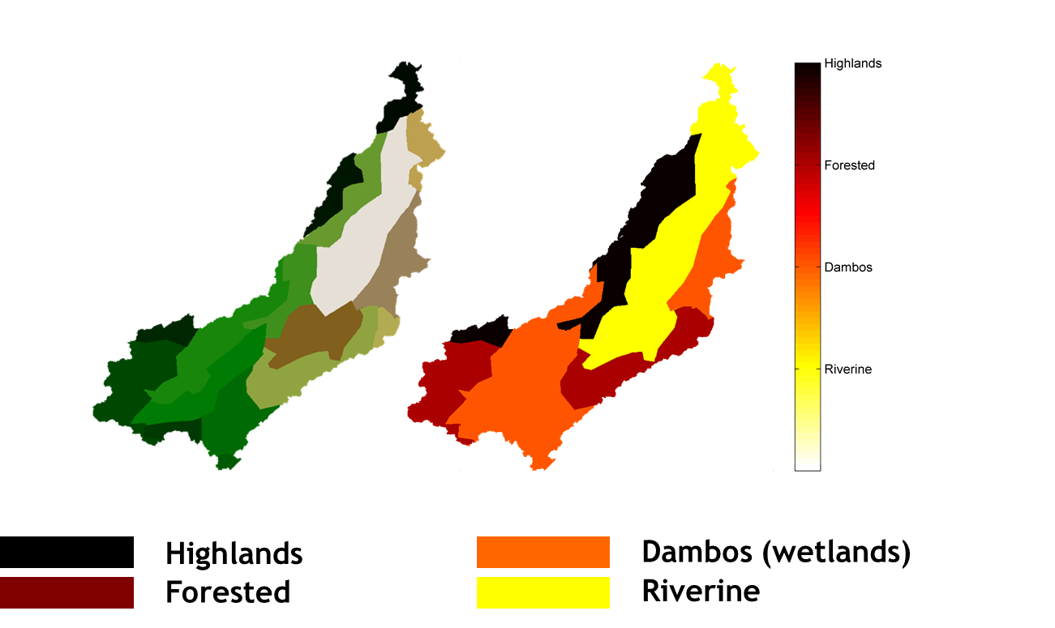
Distribution of parameters
Example Luangwa: methodology

Slide 34
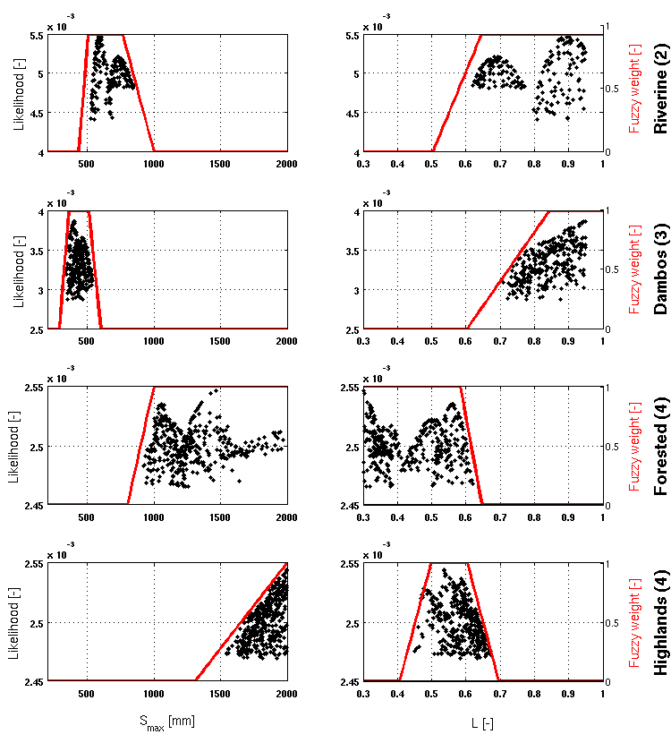
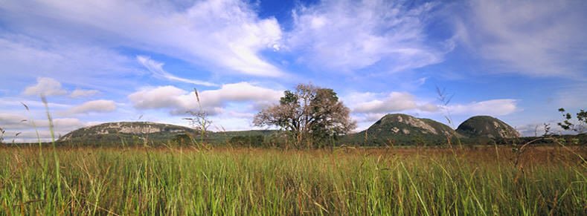
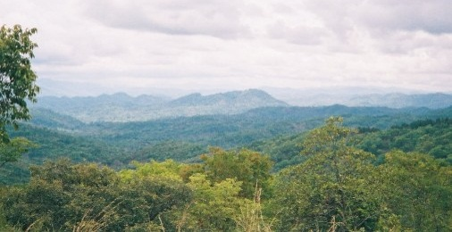
Distribution of parameters
Example Luangwa: Results

Slide 35
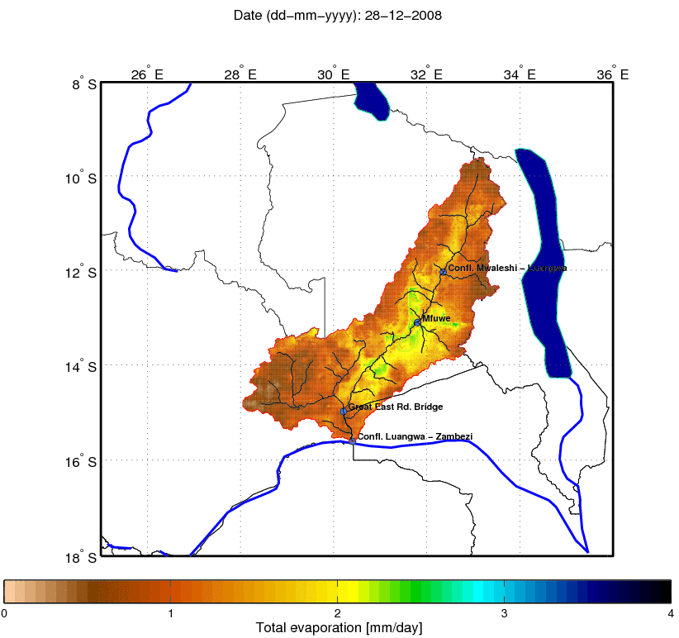
Distribution of parameters
Example Luangwa: distributed responses

Slide 36
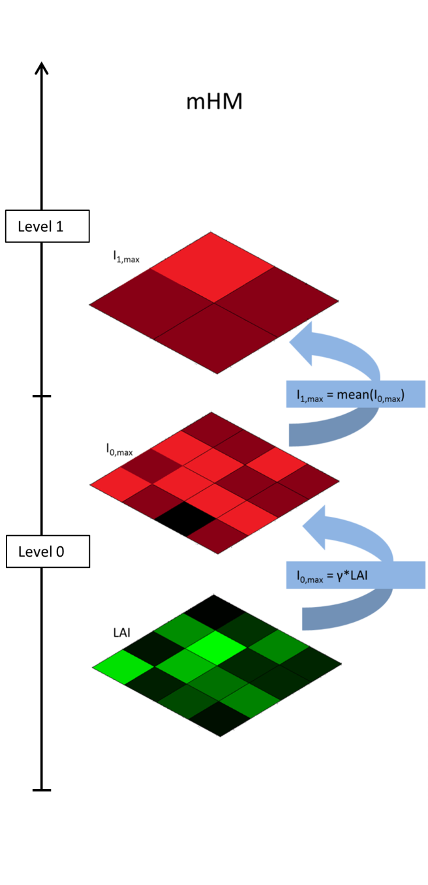
Distribution of parameters
Equifinality
How to limit equifinality in distributed models?
Transfer function methods:
Lookup tables or functions to link model parameters with soil types, land cover classes

Slide 37
Distribution of parameters
Equifinality
How to limit equifinality in distributed models?
Transfer function methods:
Lookup tables or functions to link model parameters with soil types, land cover classes
Use constraints
Parameter constraints:
I_{max, grass} < I_{max, forest}
Su_{max, wetland} < Su_{max, plateau}
Process constraints:
Q_{dry, fast, hillslope} < Q _{dry, fast, wetland}
Q_{dry, fast, hillslope} < Q _{dry, fast, wetland}

Slide 38
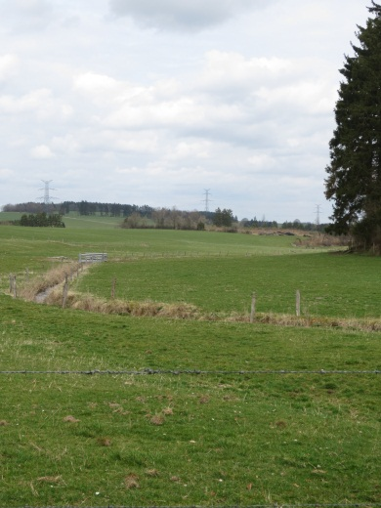
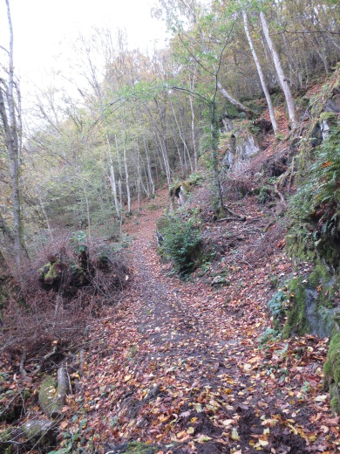
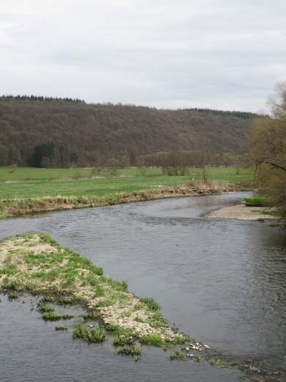
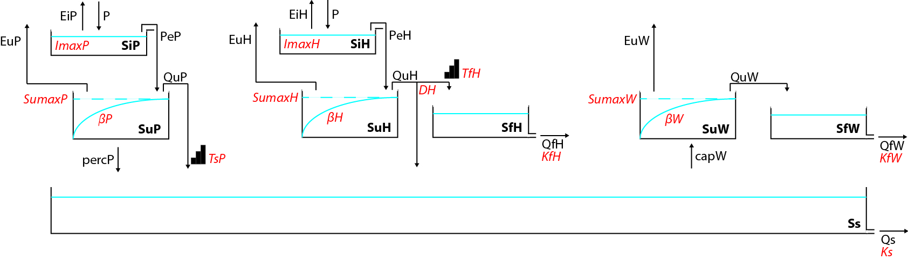
Distribution of model structure
Parallel modelling

Slide 39
Distribution of model structure
Parallel modelling
Classification required
Topography
Land use
Subsurface
Only dominant runoff processes for a each class
Processes occur simultaneously
Limited connections between neighbouring classes
Possible connection via groundwater reservoir

Slide 40
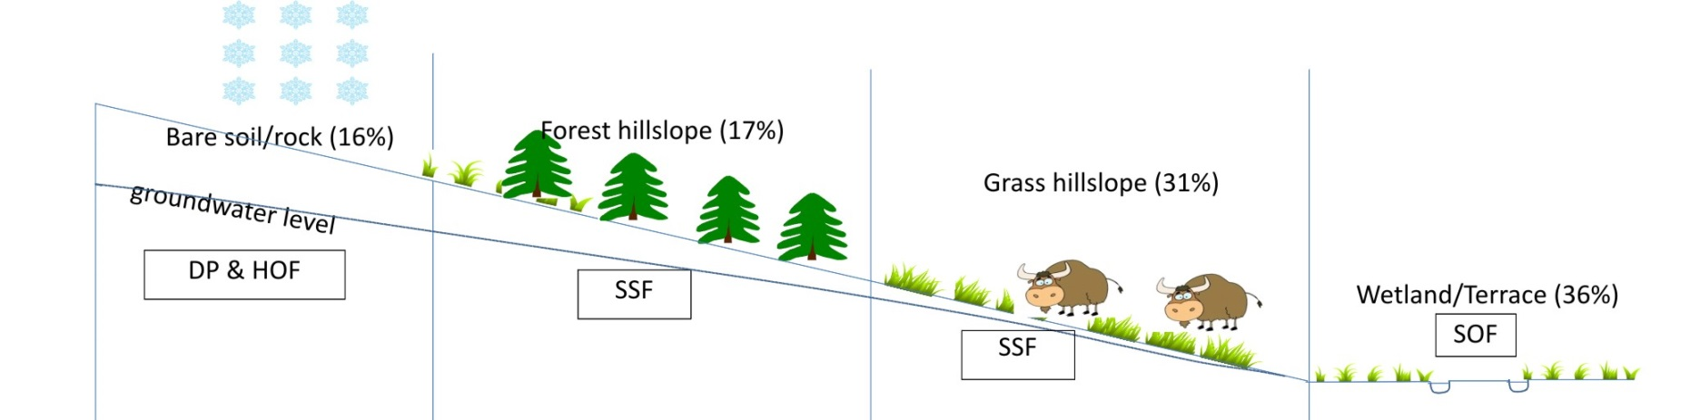
Distribution of model structure
Parallel modelling: FLEX-Topo
Height above stream
Distance from stream
Gao, HESS, 2014

Slide 41

Distribution of model structure
Parallel modelling: FLEX-Topo

Slide 42
Distribution of model structure
Parallel modelling
Assumptions
Which processes are dominant
Boundaries of hydrotopes
Testing is difficult
No measurements at appropriate scale
Extra data sources required
Internal realism checks
Transferability
Constraining based on expert knowledge can help

Slide 43
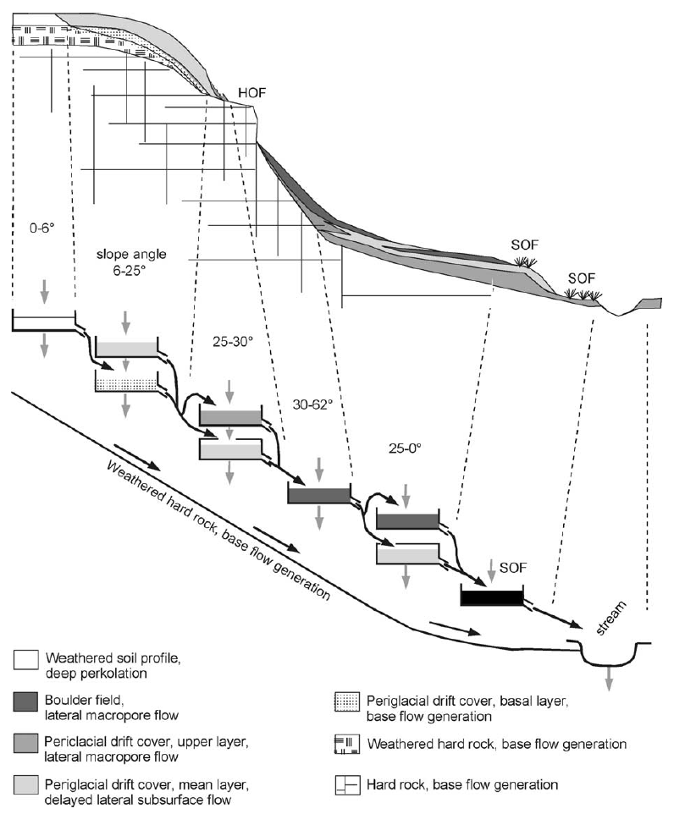
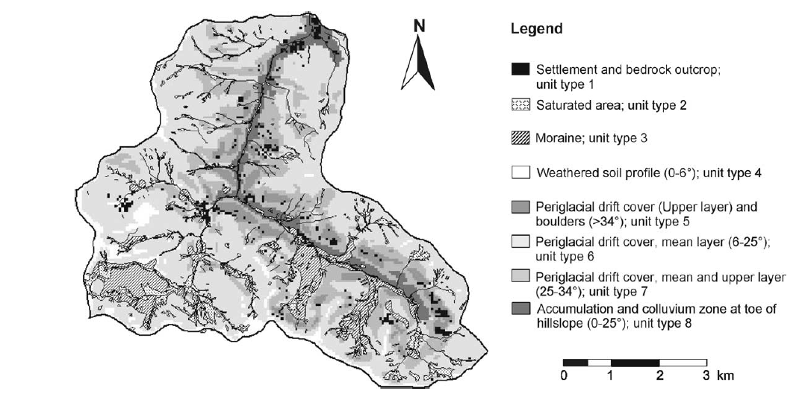
Distribution of model structure
Example testing with tracer data
Uhlenbrook et. al, JoH, 2004

Slide 44
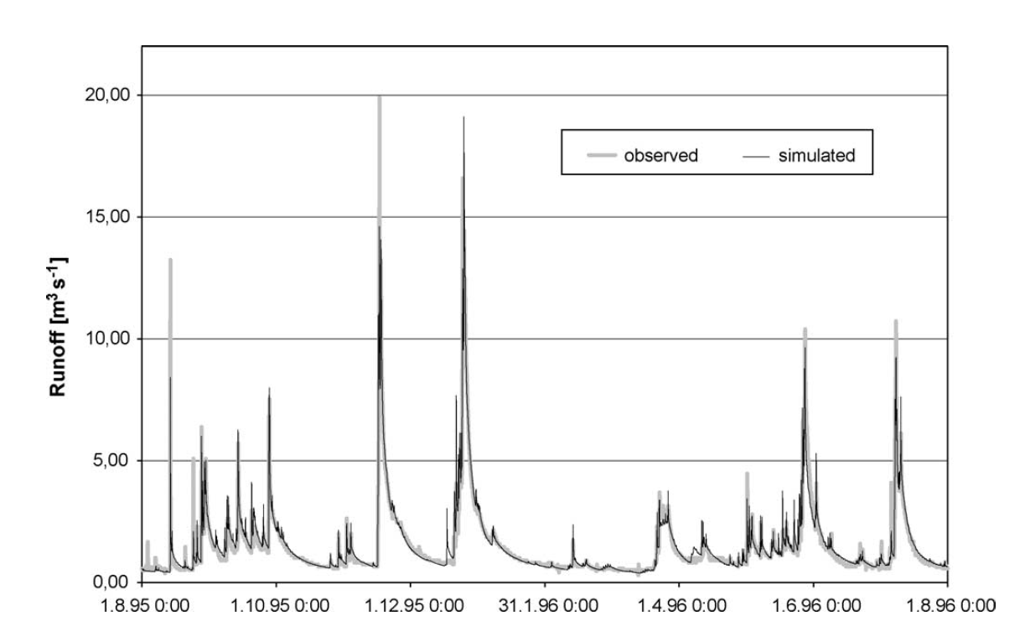
Distribution of model structure
Example testing with tracer data

Slide 45
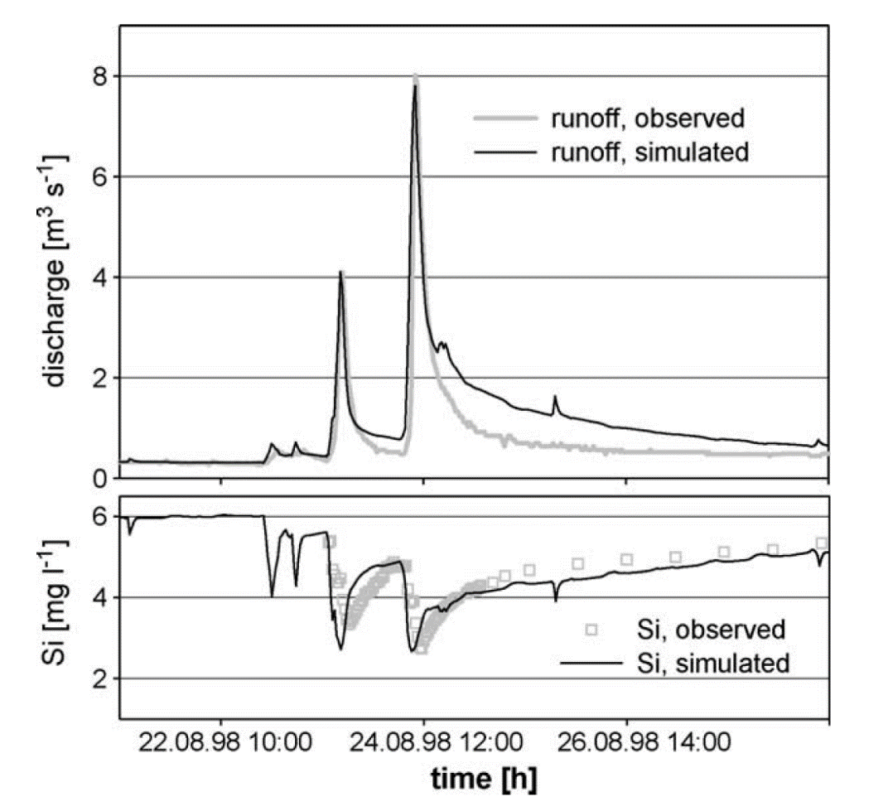
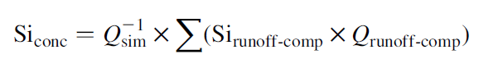
Distribution of model structure
Example testing with tracer data

Slide 46
Data sources
Introduction
History: from point to grid → geo-statistical interpolation, e.g.
Thiessen polygons (nearest neighbour)
Kriging (co-variance matrix approach)
Inverse distance weighted
See also: lecture notes hydrological measurements
General problem: by interpolating, you loose (local) extremes

Slide 47
Data sources
Introduction
Now:
Remote sensors on satellites provide new data:
… to used distributed input data,
… to help estimating parameters,
… to support distributed models.

Slide 48
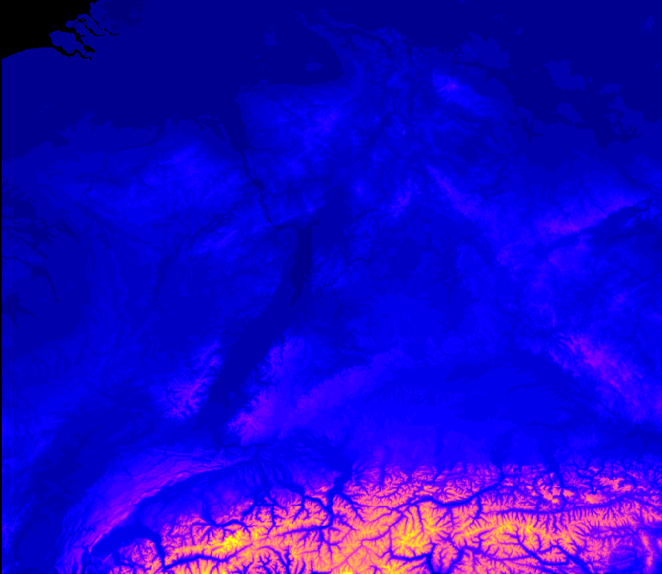
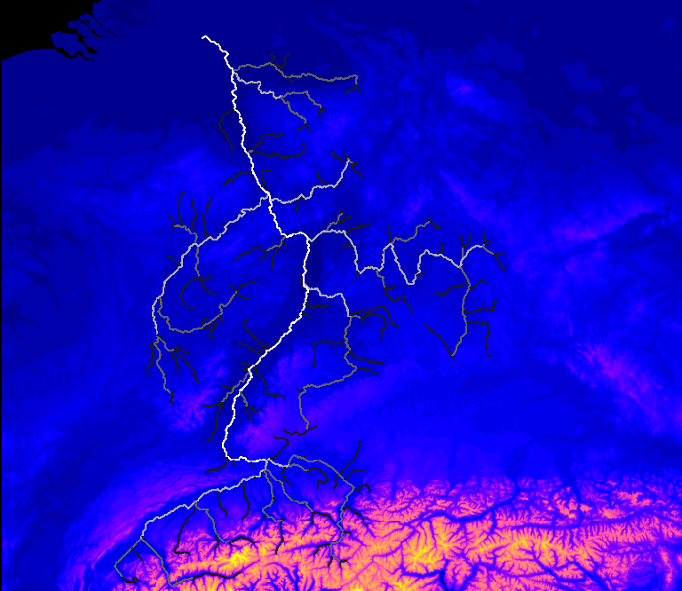
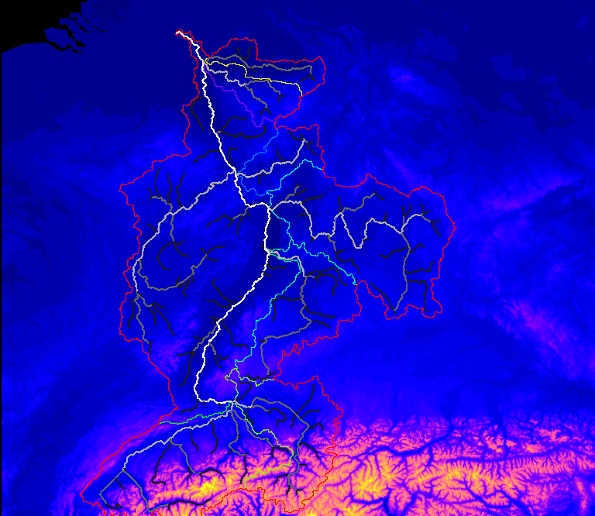
Data sources
Elevation
Hydrosheds
http://hydrosheds.cr.usgs.gov/dataavail.php
Usage:
Slopes
HAND
Drain direction
Catchment delineation

Slide 49
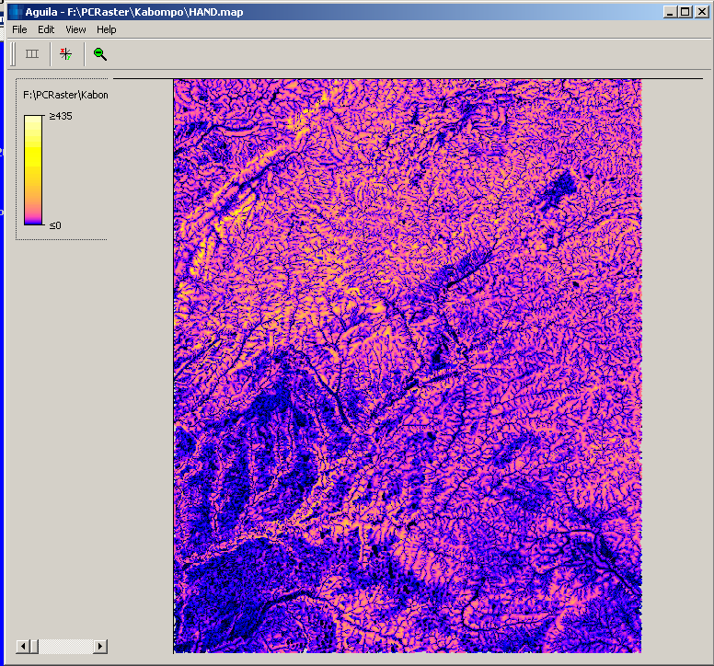
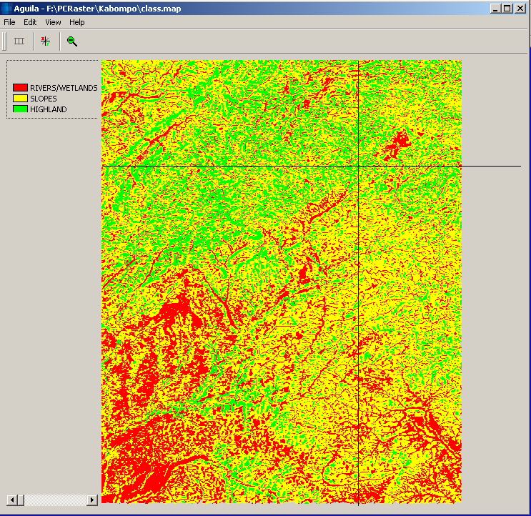
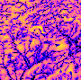
Data sources
HAND (Height Above Nearest Drain)
height almost equal to stream height
large height difference with stream

Slide 50
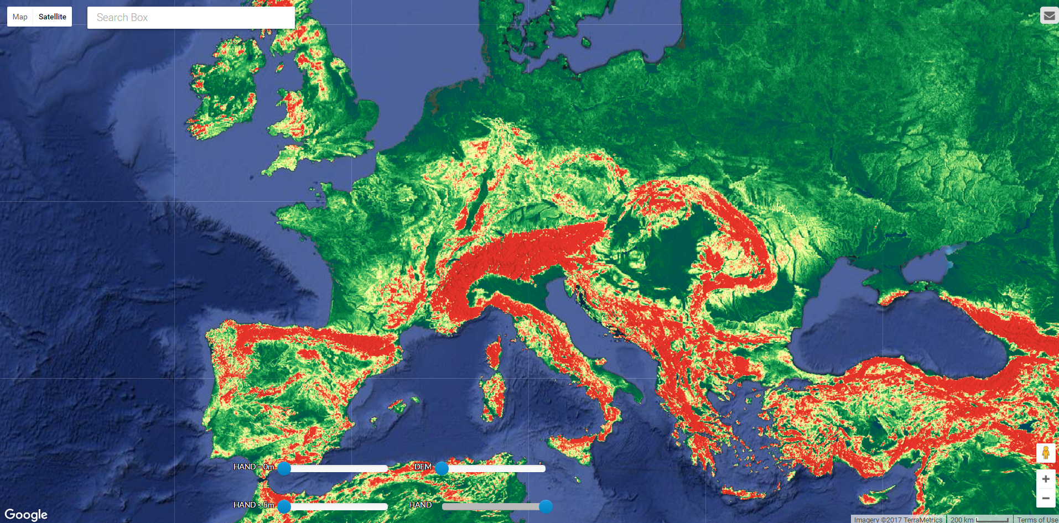
Data sources
HAND (Height Above Nearest Drain)
http://global-hand.appspot.com/

Slide 51
Data sources
Rainfall
Many rainfall products available
Eobs (0.25x0.25 º, daily, for Europe, KNMI data centre)
http://www.ecad.eu/download/ensembles/ensembles.php
Tropical Rainfall Measuring Mission (TRMM, ~25x25 km, 3-hourly)
http://pmm.nasa.gov/TRMM
GPM (since 2014)
http://pmm.nasa.gov/data-access/downloads/gpm
GSMaP (~10x10 km, 1-hourly)
FEWS RFE 2.0 (10x10 km, daily)
PERSIANN CCS (4x4 km, 30-min!!)

Slide 52
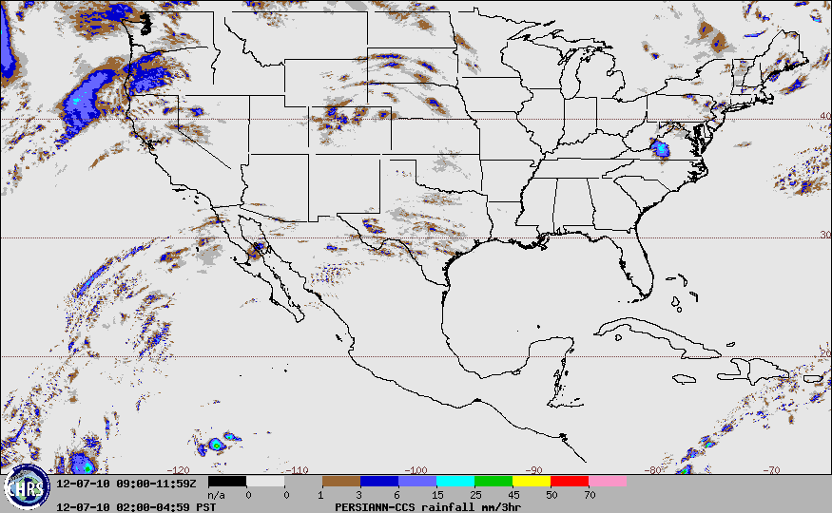
Data sources
Rainfall

Slide 53
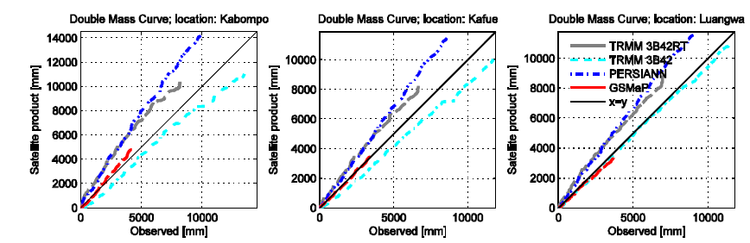
Data sources
Rainfall
Validation and bias-correction is often required!!

Slide 54
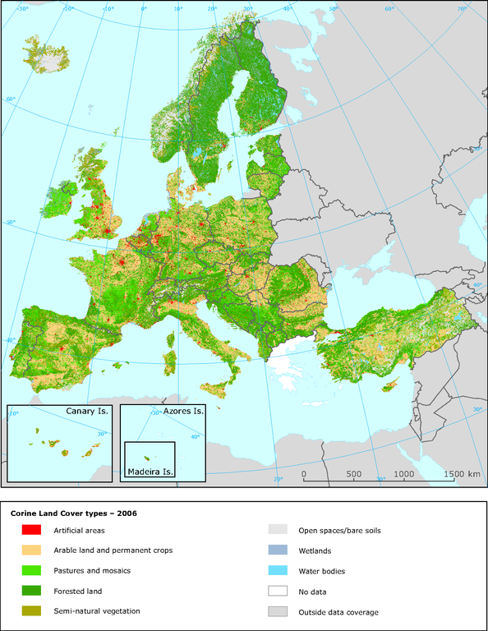
Data sources
Land cover
Globcover
http://due.esrin.esa.int/page_globcover.php
Corine
http://www.eea.europa.eu/data-and-maps/figures/corine-land-cover-types-2006
Usage:
Delineation of response units
Estimation of parameters

Slide 55
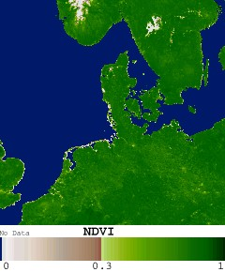
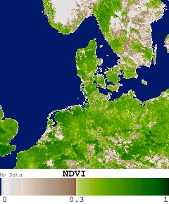
Data sources
NDVI
‘Greenness’ of the area
http://e4ftl01.cr.usgs.gov/MOLT/MOD13A1.005/
Usage:
Proxy for transpiration
Constraining of model
Delineation response units

Slide 56

Data sources
NDII
Correlation with soil moisture
Sriwongsitanon, N., et al., HESSD, 2015.

Slide 57


Data sources
Snow products
Modis snow
ftp://n5eil01u.ecs.nsidc.org/SAN/MOST/MOD10A1.005
Check for snow modelling

Slide 58

Data sources
Evaporation products
Mod16 evaporation
http://www.ntsg.umt.edu/project/mod16
LSA-SAF evaporation
https://landsaf.ipma.pt/;jsessionid=117534FA19A153B092CC5E1EBBCDF747
GLEAM
http://www.gleam.eu/#datasets
SEBAL
Forcing data
Calibration data

Slide 59
Data sources
Searching for data…
CUASHI
http://data.cuahsi.org/
SWITCH-ON
http://tl-243.xtr.deltares.nl/byod/#/map
GEOSS Portal
http://www.geoportal.org/web/guest/geo_home_stp

Slide 60
Data sources
How to use
Provide input (e.g. rainfall, (potential) evaporation)
Constrain model structures and parameterization
Mitigating the 'equifinality problem' by incorporating the spatially distributed data in a performance criterium

Slide 61

Exercises
Literature exercise:
Write a review

